Slide 1
GUVI CAPSTONE PROJECT
CRAFTING COMPELLING WEB PRESENCE- BATCH MBT8
BY SHABEEB ALTHAF MB

Slide 2


Slide 3
About Us
Samsung was founded in 1938 by Lee Byung-Chull as a grocery trading store.
Samsung is a South Korean multinational conglomerate that manufactures and sells a wide range of products, including electronics, appliances, and medical devices.
Samsung's business divisions include Consumer Electronics, Information Technology & Mobile Communications, and Device Solutions.
Samsung's headquarters are located in Samsung Digital City, Suwon, South Korea.

Slide 4
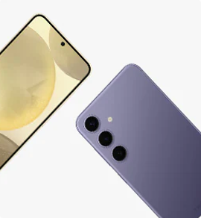
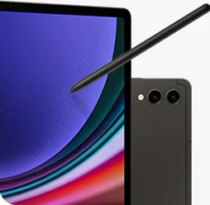
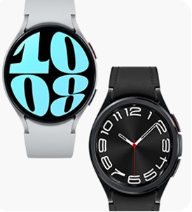

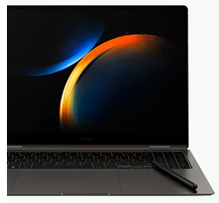
Products We are going to Cover

Slide 5
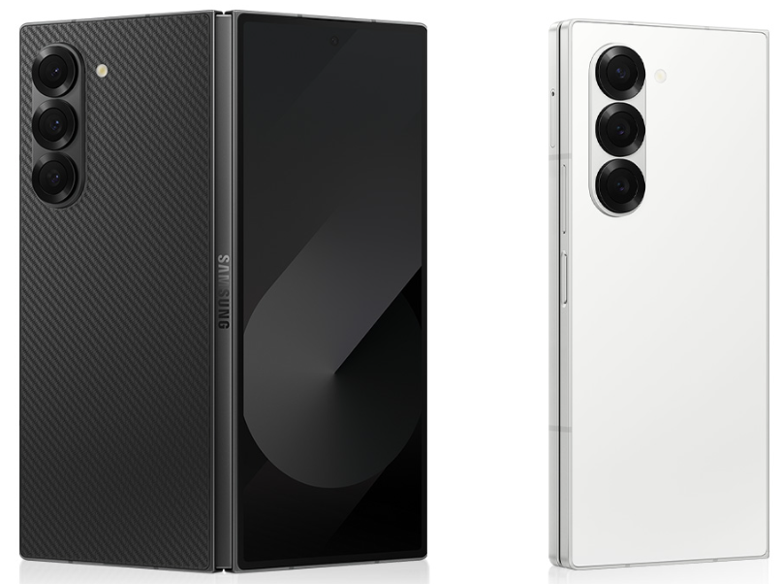
All-New Samsung Galaxy Z Fold 5
Lighter and more durable frame, potentially improving portability and robustness.
It’s powerful camera features allow it to take beautiful pictures and videos.
Improved water and dust resistance (IPX8), with a more robust outer glass (Gorilla Glass Victus 4).
Reinforced foldable screen with better scratch resistance.
Enhanced multitasking with new split-screen options and drag-and-drop functionality.
This phone is a great option for consumers looking for the newest in mobile technology because of it also adds new features and enhancements.

Slide 6
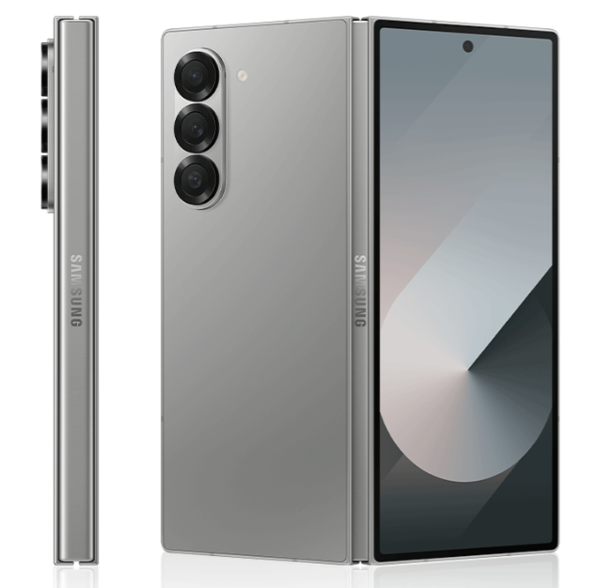
Features
Camera System:
Triple rear camera setup: Main (50 MP), Ultra-wide, and Telephoto with improved night mode, AI-based enhancements, and higher video resolution (up to 8K).
Under-display front camera refinement for a more seamless viewing experience.
Enhanced software for fold-specific camera features like dual capture, flex mode, etc.
Battery and Charging:
Larger battery: possibly up to 5000mAh, with improved battery efficiency.
Fast charging supported (45W or higher) and enhanced wireless charging speeds.
Improved power management through software optimizations.
Performance:
Powered by the latest Snapdragon 8 Gen 3 processor (or similar), delivering improved speed and efficiency.
Up to 16GB of RAM and 512GB/1TB storage options.
Better heat management for longer performance in heavy tasks like gaming and multitasking.
Display Improvements:
Primary display: 7.6-inch foldable AMOLED, possibly with an even higher refresh rate (120Hz).
Cover display: 6.2-inch Dynamic AMOLED, with edge-to-edge glass for a sleeker look.
Increased brightness and outdoor visibility, with reduced crease visibility.

Slide 7
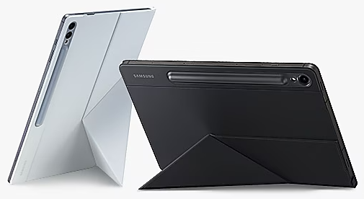
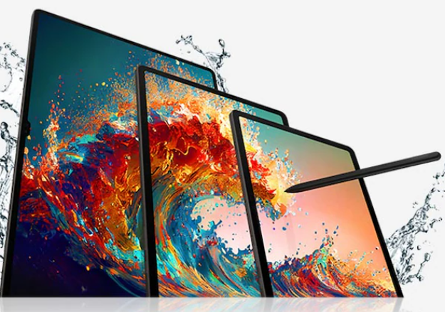
Galaxy Tab S9 Series
The Galaxy Tab S9 series, especially the larger models like the S9+ and S9 Ultra, is perfect for productivity. With the option of using Samsung DeX, you can turn your tablet into a desktop-like experience, connecting a keyboard and mouse for serious multitasking.
With the tablet’s high-quality front-facing camera and great speakers, students can engage in online classes, participate in discussions, and even present their work via video calls.
The large AMOLED displays and powerful Snapdragon processor make the Tab S9 ideal for creative professionals who work with photos and videos. Apps like Adobe Lightroom and Adobe Premiere Rush run smoothly, offering tools for content creation on the go.
Students can use the S Pen and apps like Samsung Notes, OneNote, or GoodNotes to take handwritten notes during lectures.
With the powerful Snapdragon 8 Gen 2 processor, the Galaxy Tab S9 can handle demanding games with ease. Games like Genshin Impact, Call of Duty: Mobile, and PUBG Mobile run smoothly, offering an immersive gaming experience.
The Galaxy Tab S9 series offers an array of features that cater to different users—whether you're a student, professional, artist, gamer, or just someone who enjoys media consumption. Its combination of performance, a high-quality display, S Pen functionality, and integration with Samsung’s ecosystem makes it a powerful tool for various use cases across personal and professional domains.
The Galaxy Tab S9 series represents Samsung's latest line of high-end Android tablets, blending advanced features with sleek design. This series typically consists of multiple models, including the Tab S9, Tab S9+, and Tab S9 Ultra, each catering to different user preferences in size, performance, and functionality.

Slide 8
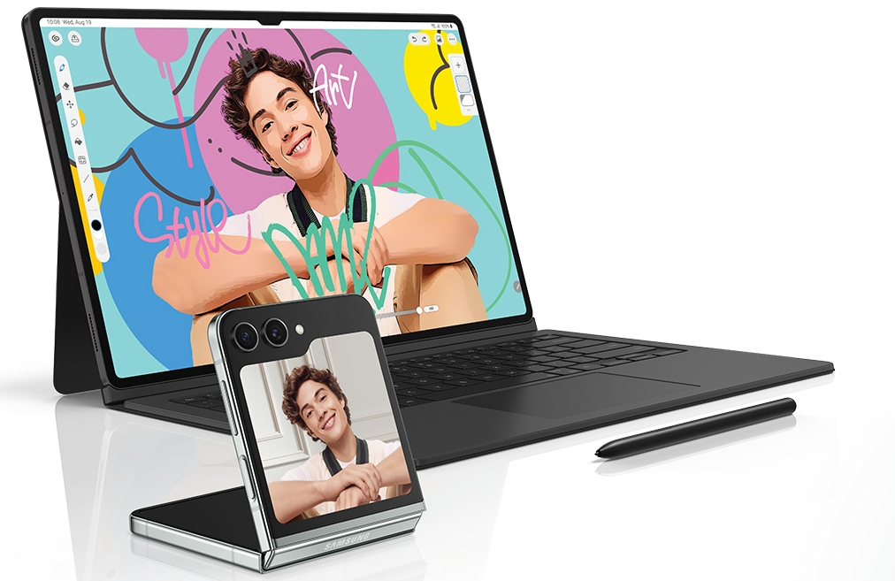
Features
Camera System:
The S9 series features an improved camera system, with a dual-camera setup on the rear for high-quality photos and video recording. While tablets are not typically camera-centric, Samsung has enhanced the optics to support video conferencing and content creation.
Battery and Charging:
The Tab S9 series packs large batteries, ensuring all-day usage for most tasks. Fast charging support helps reduce downtime, so users can quickly recharge their devices when need. Plug in your Samsung Galaxy smartphone with a USB–C cable and charging takes care of the rest.
Storage:
Choose up to 1TB internal storage, sketch your masterpiece with GoodNotes, then grab your microSD to add on more storage in case you need even more room for your videos, compositions, hi–res photos and more.
Processor: The extremely fast Snapdragon® 8 Gen 2 for Galaxy processor is intelligently engineered to deliver revved–up performance and power savings for champion-level gameplay. The graphics engine powers true–to–life reflections and shadows in 3D gaming environments for immersive gaming.
S-Pen:
With the NotePaper Screen, writing is the next best thing to pen and paper. Add in S Pen — the ultimate drawing tool to elevate your canvas. It is sensitive to pressure and tilt, allowing you to create detailed sketches and illustrations with precision and control.
Built Quality:
These tablets boast a premium aluminium frame, and the series offers IP68 water and dust resistance, ensuring durability in a variety of conditions, making them some of the most rugged tablets in their class.

Slide 9

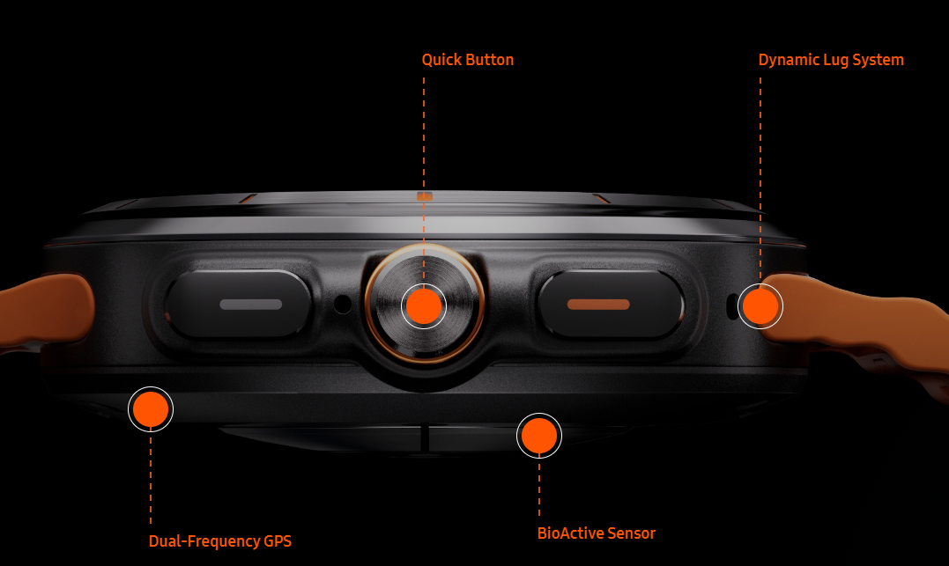
Galaxy Watch Ultra
The Galaxy Watch Ultra is Samsung's latest high-end smartwatch, designed to rival the best in wearable technology by combining rugged durability with advanced features.
Built for outdoor enthusiasts, fitness buffs, and tech-savvy users, the Galaxy Watch Ultra aims to provide a comprehensive solution for health tracking, adventure, and day-to-day productivity.
The watch comes with multiple built-in sports and exercise modes, including running, hiking, swimming, and cycling. The highly accurate GPS system ensures precise tracking of routes and distances.
The Galaxy Watch Ultra is equipped with an advanced dual-band GPS that provides superior accuracy in outdoor conditions. It is perfect for adventurers who need reliable navigation tools, whether hiking in the mountains or exploring unknown territories.
Users can choose from a wide range of customizable watch faces, and the display can show detailed information like heart rate, step count, elevation, and weather conditions.
The Galaxy Watch Ultra offers a variety of interchangeable bands, from rugged outdoor bands to more refined options for professional or casual use. The bands are easy to swap, offering versatility for different settings.
The watch integrates seamlessly with Samsung's ecosystem, allowing it to connect to Galaxy smartphones, tablets, and even the Galaxy Buds. It also supports SmartThings, making it easier to control smart home devices right from the wrist.
The Galaxy Watch Ultra is Samsung's most advanced smartwatch to date, offering a premium combination of durability, health tracking, and smart features. With a design built for extreme conditions and a robust set of tools for fitness and wellness, the Galaxy Watch Ultra is well-suited for those who lead active lifestyles and value technology that can keep up with them.

Slide 10
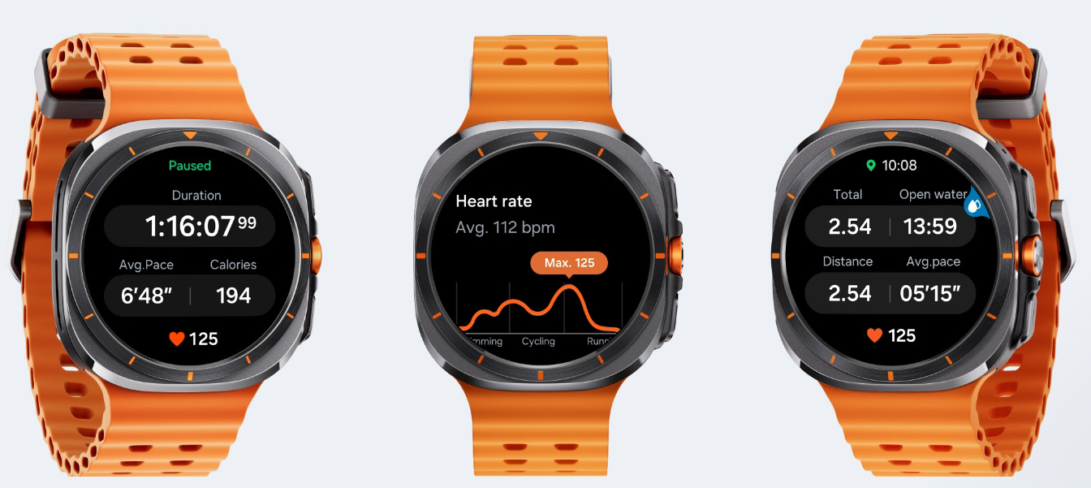
Features
Water Resistance:
Rated with 10 ATM water resistance, the watch is built for swimming, Snorkeling and even diving up to significant depths. It is also compliant with military-grade durability standards (MIL-STD-810H).
Sapphire Glass:
The display is protected by sapphire glass, making it highly resistant to scratches, even in tough outdoor conditions.
Health Metrics:
The Galaxy Watch Ultra tracks an array of health metrics, including heart rate, sleep quality, oxygen saturation (SpO2), and stress levels. The watch also offers ECG (Electrocardiogram) and blood pressure monitoring, providing valuable health insights.
Navigation: The Galaxy Watch Ultra is equipped with an advanced dual-band GPS that provides superior accuracy in outdoor conditions. It is perfect for adventurers who need reliable navigation tools, whether hiking in the mountains or exploring unknown territories.
Sports: The watch comes with multiple built-in sports and exercise modes, including running, hiking, swimming, and cycling. The highly accurate GPS system ensures precise tracking of routes and distances.
Battery:
Despite its advanced features, the Galaxy Watch Ultra is designed to offer impressive battery life, lasting up to several days on a single charge depending on usage. The watch also supports fast charging, so users can quickly recharge the battery in between uses.

Slide 11

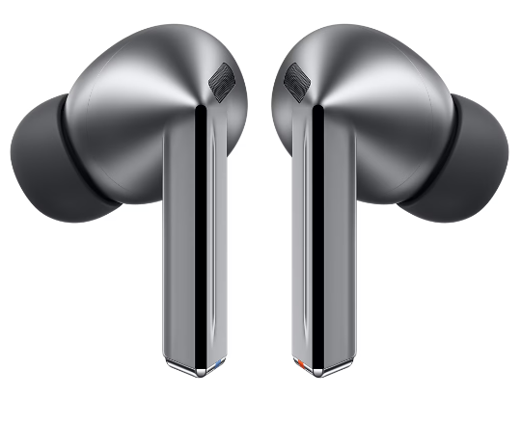

Galaxy Buds 3 Pro
The Samsung Galaxy Buds 3 Pro, Samsung's latest true wireless earbuds, bring an upgraded audio experience to users with enhanced sound quality, comfort, and advanced features. Aimed at both casual listeners and audiophiles, these earbuds are designed to integrate seamlessly with the broader Samsung ecosystem while offering cutting-edge technology for immersive audio, noise cancellation, and convenience.
The Galaxy Buds 3 Pro comes with improved active noise cancellation, capable of blocking out more external noise than previous models. The adaptive ANC feature can automatically adjust to the surrounding environment, allowing for a quieter, more focused listening experience, whether on a noisy commute or in a busy office.
The Galaxy Buds 3 Pro have been redesigned for a more comfortable and secure fit. The earbuds are lightweight, with a snug design that conforms to the ear for long-wearing comfort, making them ideal for workouts, travel, and daily use.
A quick 5-minute charge provides around an hour of playback, ensuring users are never without their music for long. The charging case supports both USB-C charging and wireless charging, making it versatile and convenient.
These earbuds also support multi-point pairing, allowing users to connect to multiple devices simultaneously. This means you can pair them with both your phone and laptop and easily switch between them without manually reconnecting.
Equipped with the latest Bluetooth 5.3 technology, the Galaxy Buds 3 Pro offer faster and more stable connections with reduced latency, ideal for gaming and watching videos.
The Samsung Galaxy Buds 3 Pro is a feature-rich pair of wireless earbuds that bring premium sound quality, superior noise cancellation, and advanced smart features to users. Whether you're a casual listener, a fitness enthusiast, or a professional on the go, these earbuds offer a versatile and immersive audio experience, with seamless integration into the Samsung ecosystem. With a perfect balance of comfort, durability, and top-notch technology, they are positioned as some of the best wireless earbuds available.

Slide 12
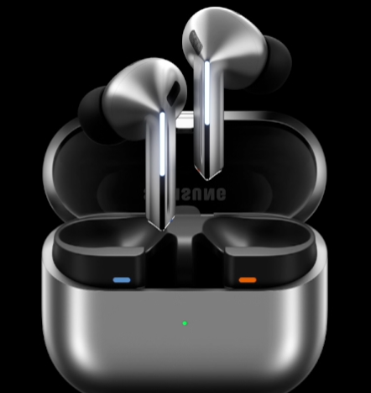
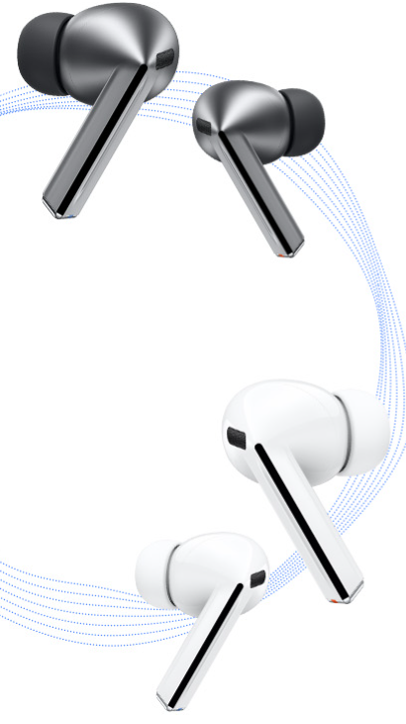

Features
Premium Sound Quality:
The Galaxy Buds 3 Pro feature a dual-driver system with separate tweeters and woofers for high and low frequencies. This allows for rich, balanced audio with deep bass and crystal-clear highs, delivering a studio-quality listening experience.
Active Noise Cancellation (ANC):
The Galaxy Buds 3 Pro comes with improved active noise cancellation, capable of blocking out more external noise than previous models.
Battery Life and Charging:
The Galaxy Buds 3 Pro offer up to 8 hours of listening time on a single charge, with up to 30 hours of total battery life when using the charging case.
Water Resistance:
The Galaxy Buds 3 Pro are rated IPX7 for water resistance, meaning they can withstand being submerged in water for up to 30 minutes at a depth of one meter. This makes them ideal for workouts, outdoor runs, and use in rainy conditions.
Seamless Connectivity:
Equipped with the latest Bluetooth 5.3 technology, the Galaxy Buds 3 Pro offer faster and more stable connections with reduced latency, ideal for gaming and watching videos.
Advanced Smart Features:
The Galaxy Buds 3 Pro integrate with Samsung’s Bixby voice assistant, allowing hands-free control over music, calls, and even smart home devices. They also support Google Assistant for Android users.

Slide 13
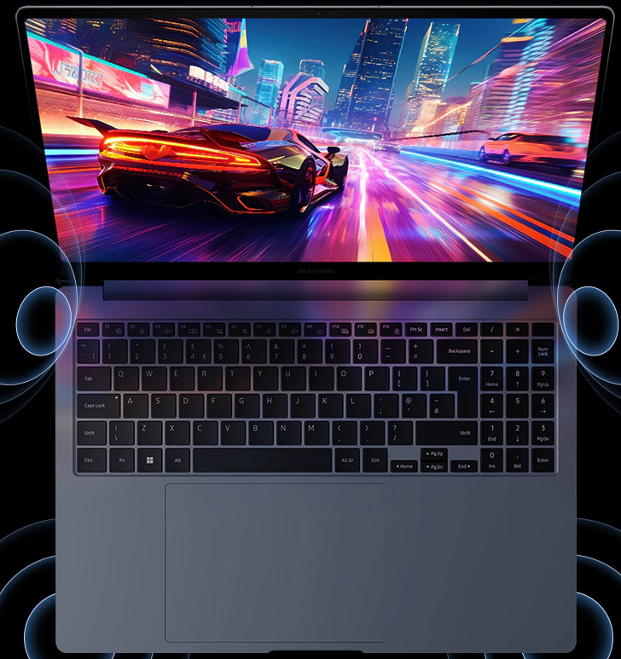
Galaxy Book 4 Ultra
The Samsung Galaxy Book 4 Ultra is a powerhouse laptop designed to meet the needs of both creative professionals and performance enthusiasts. Combining a sleek, ultra-portable design with cutting-edge hardware, the Galaxy Book 4 Ultra is a top-tier device that delivers outstanding performance for work, entertainment, and multitasking.
Whether you are a content creator, professional, or gamer, this laptop can meet a variety of high-performance needs.
The Galaxy Book 4 Ultra runs on Windows 11, giving users the latest features from Microsoft, including enhanced productivity tools, better multitasking with Snap Layouts, and a refreshed user interface.
Despite its powerful components, the Galaxy Book 4 Ultra maintains a sleek and ultra-thin design, making it easy to carry and use on the go. Weighing just over 1.7 kg, it's one of the lightest laptops in its class, ideal for professionals who are always on the move.
The laptop has a premium aluminum chassis, giving it a sturdy yet refined look and feel. The build quality is excellent, ensuring durability while maintaining a luxurious aesthetic.
The Galaxy Book 4 Ultra comes with a full range of ports, including Thunderbolt 4, USB-C, USB-A, HDMI, and a microSD card slot. This ensures you can easily connect to multiple devices and peripherals without needing additional dongles or adapters.
Equipped with Wi-Fi 6E, the Galaxy Book 4 Ultra ensures faster, more reliable wireless connections, making it ideal for high-speed downloads, online gaming, or seamless video conferencing.
The Galaxy Book 4 Ultra integrates seamlessly with other Samsung Galaxy devices, such as smartphones, tablets, and earbuds. Features like Quick Share allow users to easily transfer files between devices, and with Second Screen, a Galaxy Tab can be used as an additional display for the laptop.

Slide 14

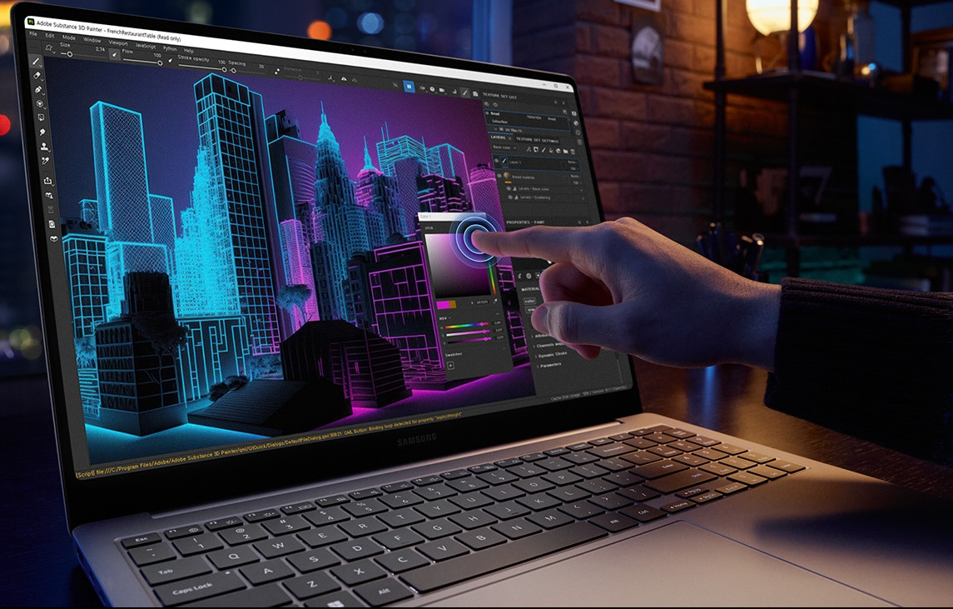
Features
Processor:
The Galaxy Book 4 Ultra is equipped with the latest Intel 13th Gen Core i7 or i9 processors, ensuring lightning-fast performance across demanding tasks.
Graphics:
The Galaxy Book 4 Ultra is equipped with the latest Intel 13th Gen Core i7 or i9 processors, ensuring lightning-fast performance across demanding tasks. Whether you’re editing high-resolution videos, running data-heavy applications, or multitasking between different programs, the laptop handles it with ease.
Battery Life and Charging:
With its large battery capacity, the Galaxy Book 4 Ultra is designed to last all day on a single charge. Whether you’re working remotely, traveling, or attending meetings, the laptop provides enough power to get you through a full day without constantly worrying about finding a charger.
Optimized for Video Calls:
The laptop comes with a high-quality 1080p webcam and AI-based noise-cancellation microphones, making it perfect for video conferences, remote work, or online classes. The AI noise-cancellation ensures clear communication even in noisy environments.
Storage:
Users can choose configurations with up to 32GB of LPDDR5 RAM, ensuring smooth multitasking even with resource-intensive applications. Whether working with massive datasets, editing high-resolution videos, or running virtual machines, the Galaxy Book 4 Ultra offers ample memory for every task.

Slide 15
Determine the Platform on Which the Website is Built

Slide 16

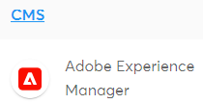


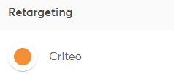


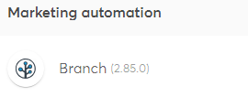


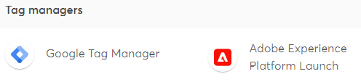


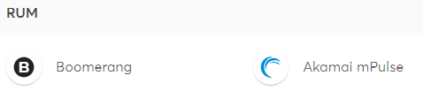


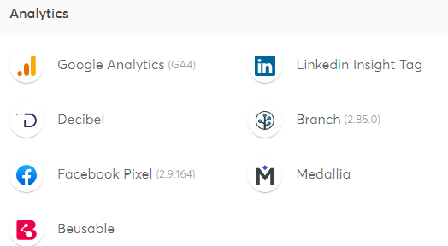



Slide 17
Tools Used
Google Chrome Developer Tools:
It offers a built-in feature that allows you to simulate how your website appears on various devices and screen sizes.
Access it by right-clicking on your webpage, select “Inspect” then toggling the device toolbar.
Viewport Resizer: Responsive design testing Google Chrome Extension.

Slide 18
Testing Pages
Shop Page
Product Page
Accessories Page
Support Page
Profile Page
Responsive - Not Responsive -

Slide 19
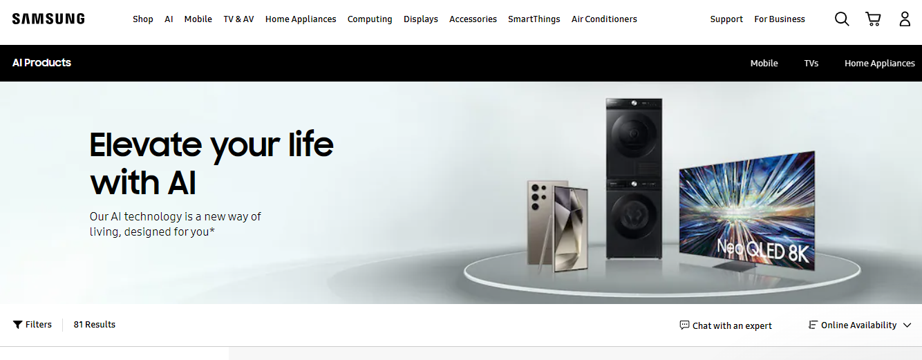
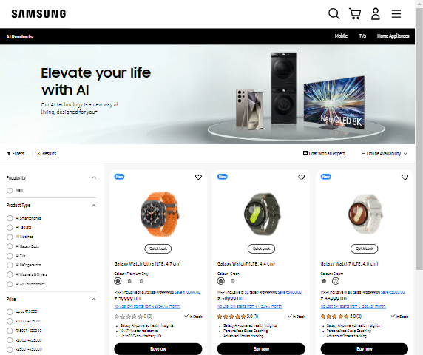
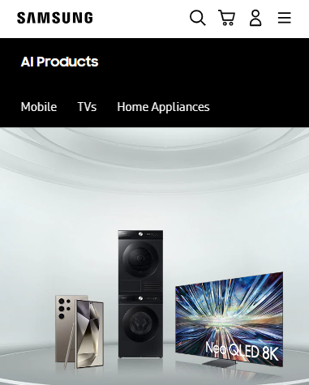
Desktop/ Laptop Full Screen:
Width: 1365x919
Tablet (Potrait)
Width: 820x1180
Mobile (Potrait)
Width: 430x932
Product Page

Slide 20
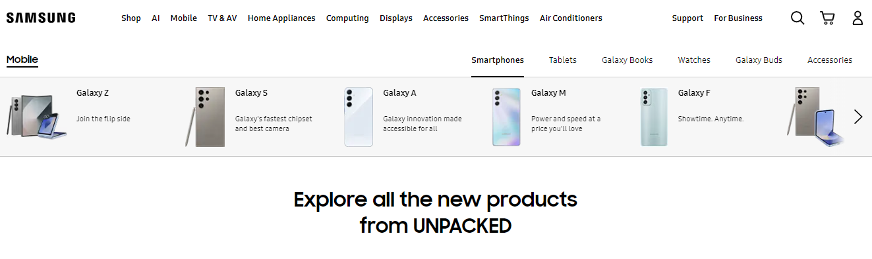
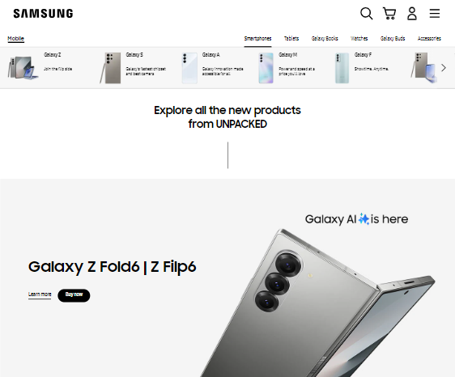
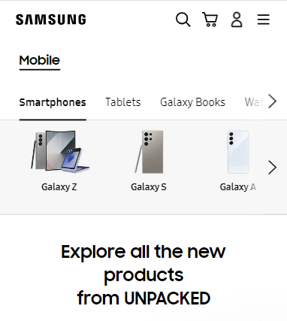
Desktop/ Laptop Full Screen:
Width: 1365x919
Tablet (Potrait)
Width: 820x1180
Mobile (Potrait)
Width: 430x932
Shop Page

Slide 21
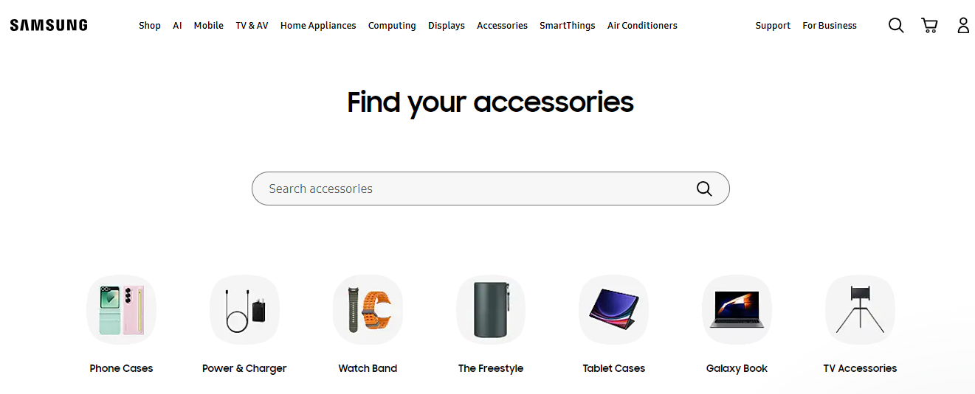
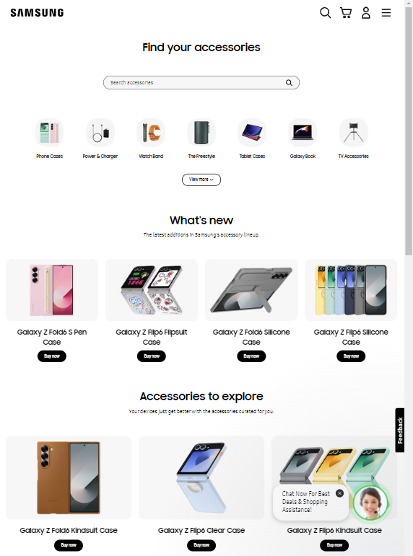
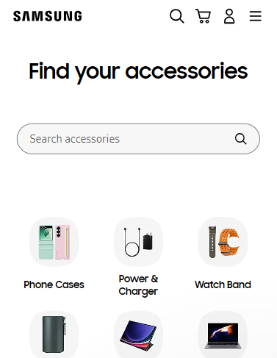
Desktop/ Laptop Full Screen:
Width: 1365x919
Tablet (Potrait)
Width: 820x1180
Mobile (Potrait)
Width: 430x932
Accessories Page

Slide 22
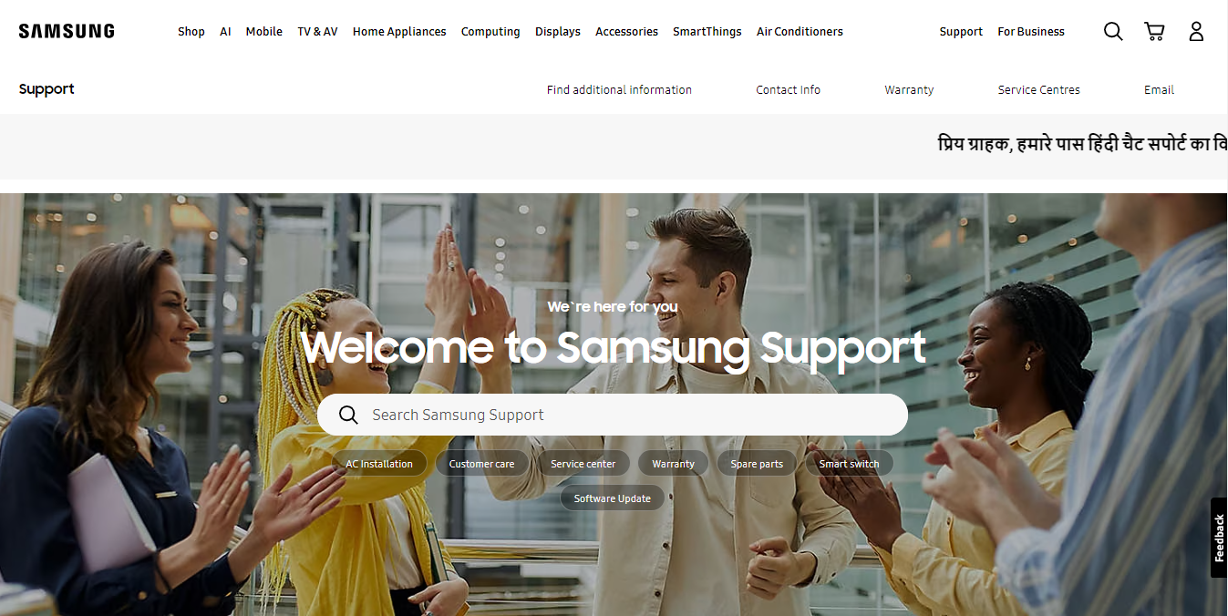
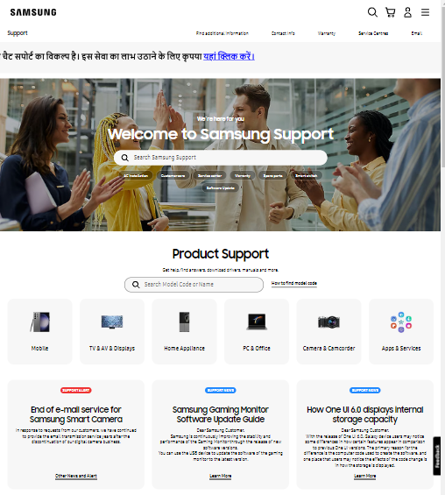
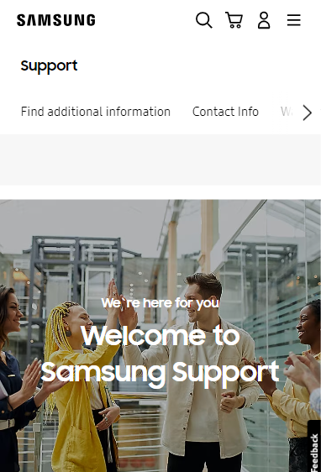
Desktop/ Laptop Full Screen:
Width: 1365x919
Tablet (Potrait)
Width: 820x1180
Mobile (Potrait)
Width: 430x932
Support Page

Slide 23
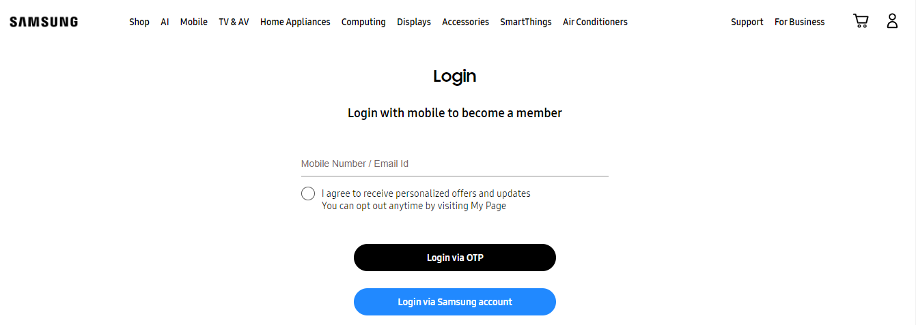
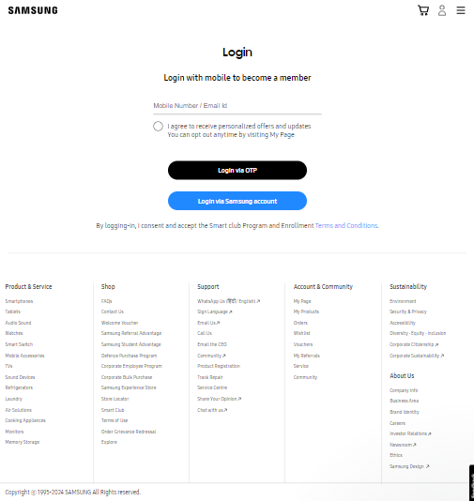
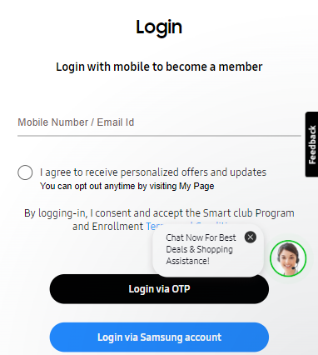
Desktop/ Laptop Full Screen:
Width: 1365x919
Tablet (Potrait)
Width: 820x1180
Mobile (Potrait)
Width: 430x932
Profile Page

Slide 24
Identify common website design mistakes to avoid, such as cluttered
Layouts and slow responsiveness times.
(List at-least 3 to 5 suggestions):

Slide 25
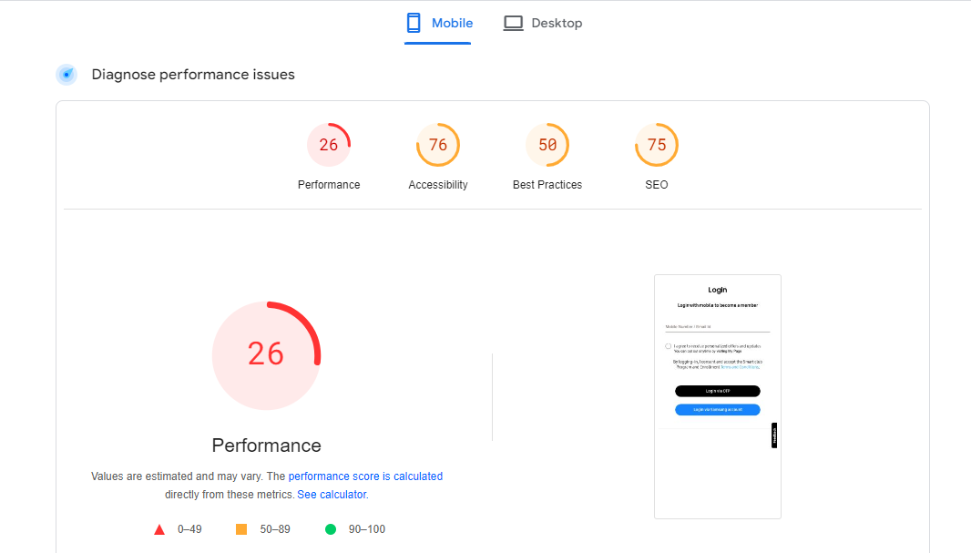
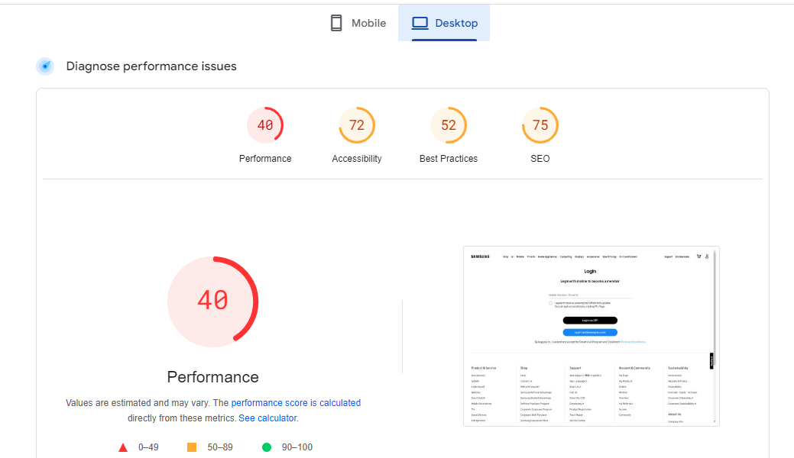
1. Optimized Loading Issues:
Issue:
The website’s performance score is very low, indicating slow loading times and poor responsiveness.
Solution:
Compress and resize images to reduce load times.
Store static files in the user’s browser cache to reduce server load.
Remove unnecessary characters from CSS and JavaScript files to reduce their size.
Deactivate and delete plugins that are not essential to improve site speed.

Slide 26
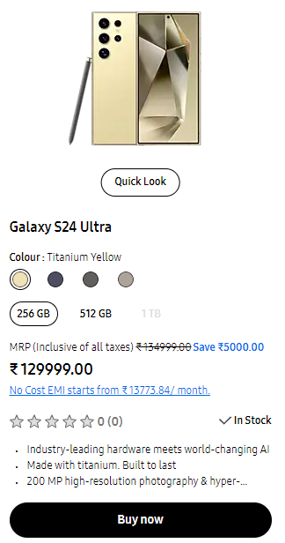
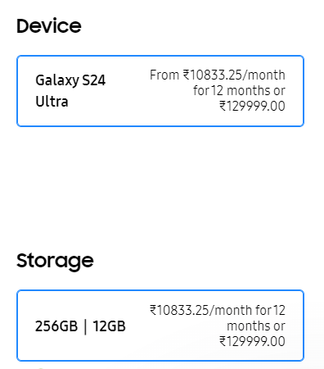
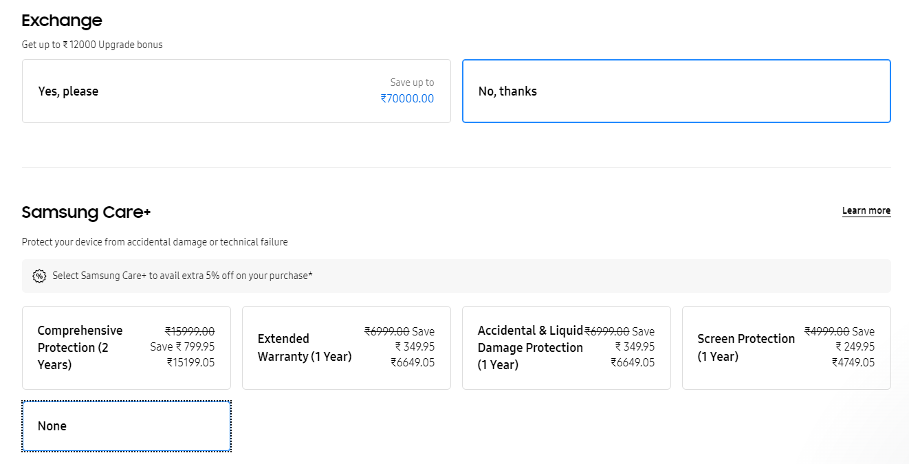
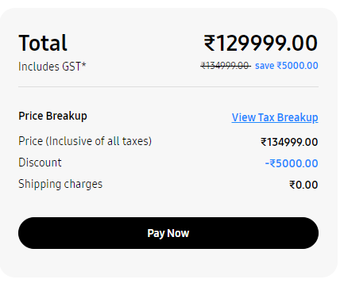
2. The checkout process takes too much time :
Issue:
The process to add items to the cart is taking too long.
Solution:
Minimize the number of pages or actions required to complete the purchase.
Only ask for essential information to complete the purchase.
Show a progress bar to inform users how many steps are left.
Collect and analyze user feedback to identify pain points and areas for improvement

Slide 27
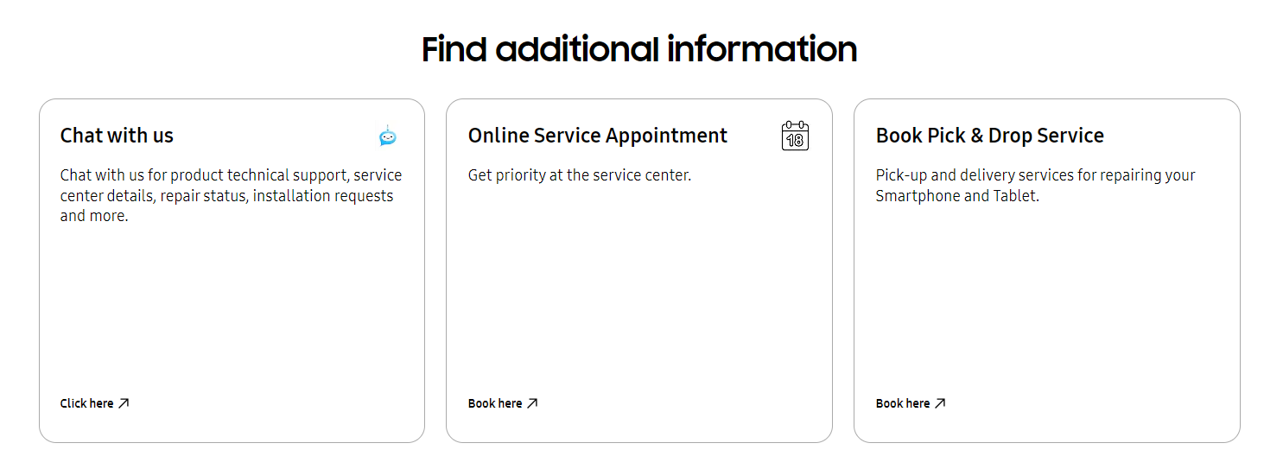
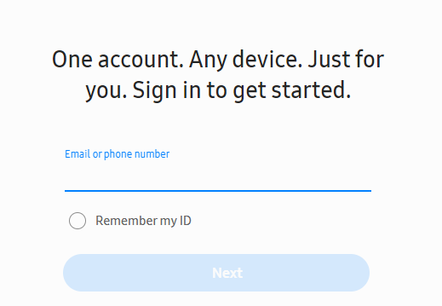
3. The support services on the webpage require users to log in via a Samsung account
Issue:
The support services on the webpage require users to log in via a Samsung account.
Solution:
Allow users to access support services without requiring a Samsung account. This can be done by providing a guest login option.
For users who choose to log in with a Samsung account, streamline the login process to make it quick and easy.
Inform users about the benefits of logging in with a Samsung account, such as personalized support and faster service, while still offering the guest access option.

Slide 28
Provide a list of best practices for creating visually appealing and user-friendly website designs:
Clean and Simple Layout: Use a clean and simple layout to make navigation intuitive. Avoid clutter and ensure that important elements are easily accessible.
Responsive Design: Ensure your website is responsive, meaning it looks and functions well on all devices, including desktops, tablets, and smartphones.
Consistent Branding: Maintain consistent branding throughout the site with a cohesive color scheme, typography, and imagery that align with your brand identity.
Fast Loading Times: Optimize images and other media to ensure fast loading times. A slow website can frustrate users and lead to higher bounce rates.
Accessible Design: Design with accessibility in mind by using alt text for images, ensuring sufficient color contrast, and providing keyboard navigation options to make your site usable for everyone, including those with disabilities.

Slide 29
Landing Page

